Slide 1
Americans with Disabilities Act (ADA) Youth Training
April 25 , 2018
Rene Cummins
Sierra Royster

Slide 2
Drop your answer in the chat box
What is in your community that is a part of Title III?

Slide 3
Prep for the Webinar
This is going to be interactive…so get ready to join in!
You will be able to join in the conversation over the phone or microphone…so speak up!
If you would like to ask a question prior to that please raise your hand. You can do that by pressing the image of a person at the top with their hand raised to voice your question or write your question in the chat box.
To mute from home, you can press *#/unmute press *#
We will have Q&A times, if you think of a question before that time please put your question in the chat box and we will come to it during the Q&A break.

Slide 4
Training Outline This is a seven week training covering the Americans with Disabilities Act.
February 14, 2018
Overview of the ADA
Disability Disclosure (1st Key)
February 28, 2018
Overview of Title 1
Reasonable Accommodations (2nd Key)
March 14, 2018
Requesting an Accommodations
(3rd Key)
March 28, 2018
Overview of Title II- State and Local Government
3 Keys
April 11, 2018
Transportation
April 25, 2018
Overview of Title III-Private Entity
3 Keys
May 9, 2018
Overview of Title IV-Telecommunication
Overview of Title V-Miscellaneous Provisions
3 Keys
Review

Slide 5
Title III- Private Businesses (Places of public accommodation)
The ADA says Title III entities have Responsibilities to-
Remove Physical Barriers
Provide Effective Communication
Modify Existing Policies

Slide 6
Title III- Private Businesses (Places of Public Accommodation)
Retail Stores
Fast-Food Places
Sports Stadiums
Private Hospitals
Shopping Centers & Malls
Banks
Restaurants
Movie Theaters
Concert Halls
Private Schools
Day Care Facilities
Doctor’s Office

Slide 7
Title III-Private businesses (Places of Public Accommodation)
Barber & Beauty Shops
Pharmacies
Hotels
Grocery Stores
Convenience Stores
Insurance Offices
Laundromats & Dry Cleaners
Recreation Facilities

Slide 8
Title III-Private Businesses (Places of Public accommodation)
The ADA requires Title III entities to do what is Readily Achievable-
Not too costly to achieve
Not too difficult to achieve
The ADA does not require Title III entities to do what would be an Undue Burden.

Slide 9
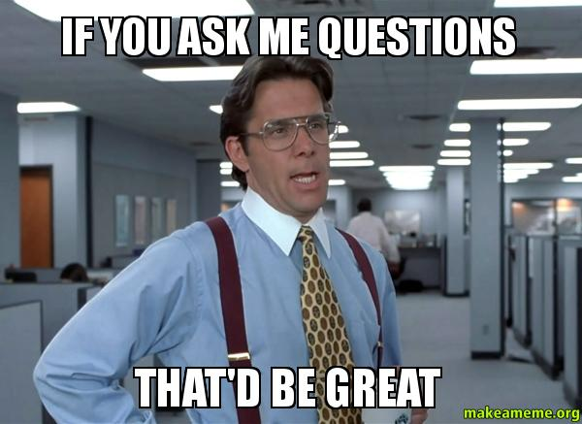
Q&A

Slide 10
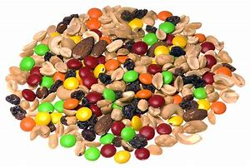
Creating your trail mix
Think of the past weekend…
How many public entities did you travel to?
For each entity you have to add an ingredient into the bowl.
See who has the biggest mix of your trail this past weekend.

Slide 11
Wrap Up
Next Training date
May 9, 2018 from 4:00-5:00pm(EST) (3:00-4:00pm CST, 2:00-3:00pm MST, 1:00-2:00pm PST)
Title IV Telecommunication
Title V Misc. Provisions
Review

