Slide 1
Americans with Disabilities Act (ADA) Youth Training
March 28, 2018
Rene Cummins
Sierra Royster

Slide 2
Drop your answer in the chat box
What is in your community that is a state and local government?

Slide 3
Prep for the Webinar
This is going to be interactive…so get ready to join in!
You will be able to join in the conversation over the phone or microphone…so speak up!
If you would like to ask a question prior to that please raise your hand. You can do that by pressing the image of a person at the top with their hand raised to voice your question or write your question in the chat box.
To mute from home, you can press *#/unmute press *#
We will have Q&A times, if you think of a question before that time please put your question in the chat box and we will come to it during the Q&A break.

Slide 4
Training Outline This is a seven week training covering the Americans with Disabilities Act.
February 14, 2018
Overview of the ADA
Disability Disclosure (1st Key)
February 28, 2018
Overview of Title 1
Reasonable Accommodations (2nd Key)
March 14, 2018
Requesting an Accommodations
(3rd Key)
March 28, 2018
Overview of Title II- State and Local Government
3 Keys
April 11, 2018
Transportation
April 18, 2018
Overview of Title III-Private Entity
3 Keys
May 9, 2018
Overview of Title IV-Telecommunication
Overview of Title V-Miscellaneous Provisions
3 Keys
Review

Slide 5
Title II State & Local Government
The ADA says you have the RIGHT to-
Equal Access to all programs, services & activities
Full Participation in all programs, services & activities
Everybody or Nobody!

Slide 6
Title II State & Local Government
The ADA says Title II entities have RESPONSIBILITIES to-
Remove Physical Barriers
Provide Effective Communication
Modify Existing Policies
Public Tax Dollars-Higher Standard

Slide 7
Title II State & Local Government
City Auditoriums
Libraries
Parks & Recreation
Voting Places
Public Schools
Visitors Centers
Public Access TV

Slide 8
Title II State & Local Government
City Council
County Commission
Police Services
Fire Department
Emergency Services
Community Theaters
Sidewalks & Streets
Public Transit

Slide 9
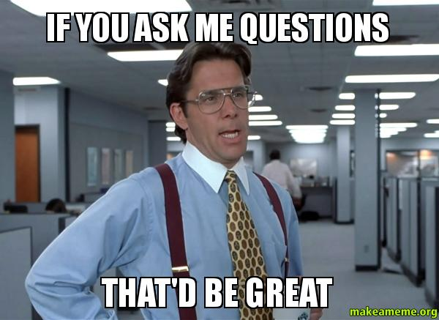
Q&A

Slide 10
Bill of rights
Rights-things you are entitled to or deserve.
Responsibilities-things you are expected to do.
Citizen
Free Education
Fair and equal treatment
All citizens over 18 may vote
To care for streets, public places, and education
Own property
Freedom
To show up to learn.
Treat other with respect
To vote
Pay taxes
Pay and take care of property
Obey laws

Slide 11
Bill of rights
Rights-things you are entitled to or deserve.
Responsibilities-things you are expected to do.
Advocate
Two teams-
Team Ketchup-A-J
Team Teacups-K-Z
I am going to name an area of responsibilities.
You are going to think of as many examples of this area as you can.
Remove Physical Barriers
Modify Existing Policies
Provide Effective Communication

Slide 12
Wrap Up
Next Training date
April 11, 2018 from 4:00-5:00pm(EST) (3:00-4:00pm CST, 2:00-3:00pm MST, 1:00-2:00pm PST)
Title II State and Local Government-Public Transportation
Homework
Identify a example when you had a problem with public transit?

