Slide 1
Americans with Disabilities Act (ADA) Youth Training
February 28, 2018
Rene Cummins
Yolanda Vargas

Slide 2
What is a reasonable accommodation?
Drop your answer in the chat box

Slide 3
Training Outline This is a seven week training covering the Americans with Disabilities Act.
February 14, 2018
Overview of the ADA
Disability Disclosure (1st Key)
February 28, 2018
Overview of Title 1
Reasonable Accommodations (2nd Key)
March 14, 2018
Requesting an Accommodations
(3rd Key)
March 28, 2018
Overview of Title II- State and Local Government
3 Keys
April 11, 2018
Transportation
April 18, 2018
Overview of Title III-Private Entity
3 Keys
May 9, 2018
Overview of Title IV-Telecommunication
Overview of Title V-Miscellaneous Provisions
3 Keys
Review

Slide 4
What does disability mean to you?

Slide 5
Overview of ADA
Title I-Employment
Public Entities State and Local Government
1 or more employees
Private Employers and 15 employees

Slide 6
2nd Key-Reasonable Accommodations
What is a reasonable accommodation
What are your answers?
Lets learn more!

Slide 7
Reasonable Accommodations
When do you request?
Application
Interview
Initial Job Offer
On the Job

Slide 8
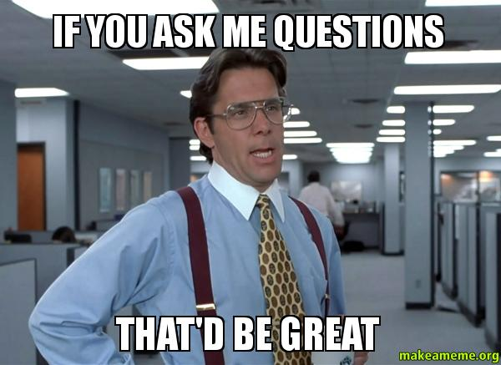
Q&A

Slide 9
Fortune Teller
Pick a color
Red, Blue, Green, Pink
Pick a number
Application
Interview
Initial Job Offer
On the Job
Answer the question?

Slide 10
Processing

Slide 11
Wrap Up
Next Training date
March 14, 2018 from 4:00-5:00pm(EST) (3:00-4:00pm CST, 2:00-3:00pm MST, 1:00-2:00pm PST)
How do you Request an Accommodation?
Pick one of the 4 areas and request an accommodation you may need in this area?

