Slide 1
IL-NET Presents an IL Conversation
Join today’s conversation:
If you move your cursor (or your mouse) then the following items will pop up at the bottom or top of your screen
Left hand bottom corner of your screen has a microphone to mute your audio
By pressing the chat bubble you can type a question in for us from your computer
You can raise your hand to let us know you have a question or comment by clicking “Raise your Hand” with the hand icon on your screen
You can ask a question by typing in the Q and A box with a little file folder
If you are on the phone you can unmute and mute from home with *6
Captions will be provided in the webinar platform. You must click the caption option on your toolbar to view it. If you would prefer you can visit: https://www.streamtext.net/player?event=APRIL for full screen captions.
If you are having any trouble participating please email mary.olson@mso.umt.edu for immediate assistance

Slide 2
The IL-NET is a national training and technical assistance project for centers for independent living and statewide independent living councils. The IL-NET is operated by Independent Living Research Utilization (ILRU) in partnership with the National Council on Independent Living (NCIL), the Association of Programs for Rural Independent Living (APRIL), and Utah State University Center for Persons with Disabilities.
The IL-NET is supported by grant numbers 90ILTA0001 and 90ISTA0001 from the U.S. Administration for Community Living, Department of Health and Human Services, Washington, D.C. 20201. Grantees undertaking projects under government sponsorship are encouraged to express freely their findings and conclusions. Points of view or opinions do not, therefore, necessarily represent official Administration for Community Living policy.

Slide 3
Staff Retention: Investing in Your Staff for a Stronger Tomorrow
Brooke Curtis and Scott Burlingame

Slide 4
Today’s Discussion Will Cover:
Finding and hiring staff
Training and support
Building a culture
Clarified expectations

Slide 5
Guiding Discussion Questions to Consider for Today’s Conversation:
How do you recruit staff?
How do you decide what you’re looking for when hiring?
How do you create a culture where people will want to stay?
How do staff bring forth ideas for organizational growth?
How do staff know if they’re doing a good job?
Why do you stay at your job?

Slide 6
Introducing Brooke
Training and Technical Assistance Specialist at ILRU
Previously worked in recruiting and managed a staff of 40 in a high turnover industry. Improved retention through ambassador and mentorship program and staff appreciation events and awards. Franchise location awarded for highest total revenue growth and highest employee growth for locations up to $750,000 in 2017.
Played a notable role in launching a young professional group and Junior Board for a non-profit.

Slide 7
Introducing Scott
Executive Director at Independence, Inc., a Resource Center for Independent Living in Minot, ND.
Independence, Inc. has a staff of 9 people, and a budget of around $670,000
Over 20 years of experience as a supervisor/manager.
Over the last 8 years, Independence, Inc. has went from 60-70% annual turnover, to less than 10%.
During that same time, we have increased our consumer caseload by 600%, increased our community profile drastically, and positioned ourselves as a leader of local community and systems advocacy.

Slide 8
“You can’t make up for in training what you messed up in hiring.”
-Unknown

Slide 9
Recruiting to Hiring
Sourcing
Inbound/internal candidates
Outbound (LinkedIn, Indeed, ILRU website, community events, etc.)
Referrals
Screening
Meet requirements
What do you look for when reviewing applications?
Can conduct phone screens prior to in-person interviews

Slide 10
Recruiting to Hiring, cont’d
Interview question example set 1
What do you think is the most important aspect of management and why?
Do you like working with people?
Interview question example set 2
Tell me about a time when you handled a difficult situation.
Describe a time when you worked as a team to accomplish a goal.

Slide 11
Best Practices in Hiring
Be careful to take your time and do your due diligence.
It is better to leave a spot open than it is to hire the wrong person.
Don’t allow your desire to fill a seat override your best judgement.
The wrong employee is often more damaging than no employee.

Slide 12
Training, training, and training
www.ILRU.org
Self-paced courses
Online courses
On-location trainings
Webinars
Some ideas
Mentorship
Site visits to other CILs
Creating a training plan
Monthly all-staff meetings
Staff competitions (ex: drawings for gift cards)

Slide 13
Establish a Disability Rights Friendly Culture
Constantly review Disability History and work to define disability culture.
Encourage public displays of disability pride.
Radically accommodate disabilities
Set high expectations.

Slide 14
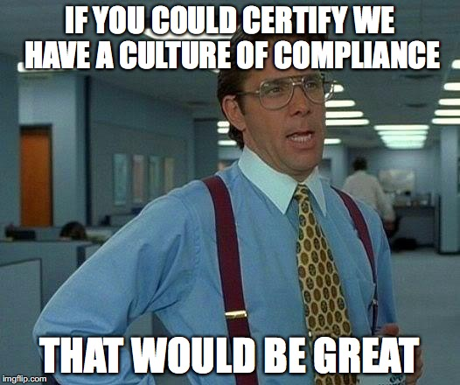
Organizational Culture

Slide 15
Why Do People Stay?
Leadership and planning,
Corporate culture and communications,
Pay and benefits,
Training, development, and resources,
Engagement,
Role satisfaction, and
Work environment.
Source: https://www.thebalancesmb.com/why-people-want-to-work-for-nonprofits-2502377

Slide 16
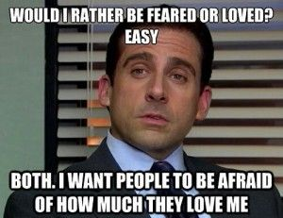

Slide 17
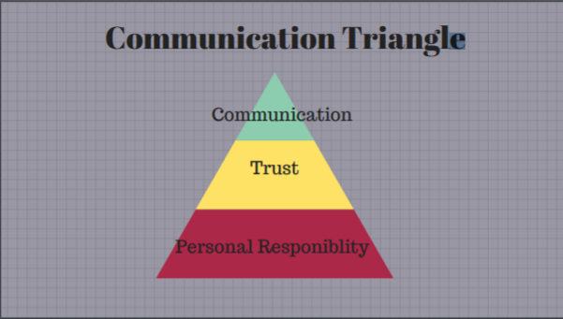

Slide 18
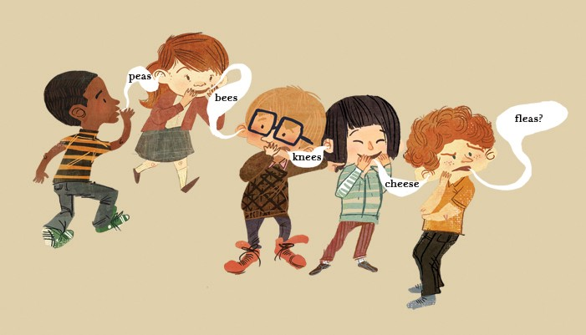
Clarified Expectations
Don’t let it be like a game of telephone!
Image retrieved from https://theosophical.files.wordpress.com/2014/12/telephone-game.jpg

Slide 19
From Conversation to Implementation
If someone isn’t right, it isn’t my fault.
You don’t have to do it all by yourself. Utilize the skill set of your team and be open to feedback from staff

Slide 20
Thank You!
Evaluation for Today’s Discussion: https://usu.co1.qualtrics.com/jfe/form/SV_0INkJ00Q5ASk1hz
Materials from todays call including example succession plan:
https://www.april-rural.org/index.php/il-conversations
Thank you to our speakers:
Brooke Curtis: Brooke.Curtis@memorialhermann.org
Scott Burlingame: scottb@independencecil.org

