Slide 1
Promoting Disability Pride: Exploring the Evolution of Disability Culture
IL Conversation
March 5, 2015
Facilitated by Steven E. Brown,
Co-Founder, Institute on Disability Culture
Professor (Retired, currently Affiliate Faculty)
Center on Disability Studies, U. of Hawaii

Slide 2
Exploring a Personal and Professional History of the
Evolution of Disability Culture

Slide 3
Some Personal History
*Doctorate in History, 1981
*Working at a CIL in Oklahoma in 1980s
*Reading Disability Rag (disability cool; Mary Johnson’s interview with Carol Gill)
*Presentation at NCIL, 1990, “Speakers of Movement”
*Working at WID, 1990-1993

Slide 4
”Tell Your Story” (1991, 1995) All Rights Reserved, Institute on Disability Culture www.insituteondisabilityculture.org
Tell your story
Tell your story
It may bump from the page
like words of braille
sizzling in tales of blazing glory;
it may glisten in the sunshine like the holy grail,
so tell me a tale, even if it’s gory,
I’m yearning to hear you
Tell your story.
Have you heard
‘bout the man
in the motorized chair?
Found no ramp at the
movie theater
did he despair?
No,
just let them dudes lift him in there.

Slide 5
”Tell Your Story” (continued)
Came back a few days later
after somethin’ greater
brought with him a crew
people in chairs just grew and grew,
said they knew
they’d be part of the view;
no problem getting in,
just lift and push and
move those hunks of tin.
The chairs, they weighed a-plenty,
The ushers stressed and
strained and got somewhat benty.
Seeing the movie was not the goal
changin’ the stage was the whole
they paid for getting’ in
but that theater knew it sinned.
People in chairs sealed their own personal stamp
on that theater’s shimmering new wheelchair ramp.

Slide 6
”Tell Your Story” (continued)
Tell your story
Tell your story
It may enrapture the floating air
like ASL* singing its flair
it might even glisten like the holy grail,
but no one will set their sail
toward your tale,
even if it’s hunky-dory,
unless you tell your story
Tell your story.

Slide 7
”Tell Your Story” (continued)
Once I knew a lady
got caught in a picket line
changed her whole design:
came back to her hometown
mission bound.
Told a hospital it was ailing
cause it was failing to see
good health bound in the key of
phone lines hooked up with a TDD.**
Said she’d seek cooperation or
she’d be mighty angry
might even round up folks and
stoke fires of insurgency,
gather signatures and seek publicity.
You know that hospital saw the light
put an end to the no TDD blight.

Slide 8
”Tell Your Story” (continued)
Last time I saw that lady
she was waving a sign
telling a TV station
she sure did mind
no news she could see
so why should she
listen to what they wanted her to be.
Now she knows how to stick it
with a picket and her
pockets have been lined with Advocacy.

Slide 9
”Tell Your Story” (continued)
Tell your story
Tell your tale
You will find you touch
with the sureness of a crutch
a framework for your dwelling,
a story needing telling,
steaming like a sunburnt trail
glistening like the holy grail.
Who will know what you entail
unless you risk the path to glory
tell your story
Tell your story.
Does he want another cup of coffee?
I heard the waitress ask about the man.
How did I know his plan?
Just cause he couldn’t see
didn’t mean his brain rested in incompetency.
The stories he has told
brisk and bold
I’ve shared with more than a few
over a cup of coffee or a tall, cold brew.

Slide 10
”Tell Your Story” (continued)
The lessons are in the telling
they provide a framework and a dwelling.
We all have so many stories to bear
Cry, laugh, sing, and despair;
how will our children learn and compare
if we’re too timid to dare
to raise the flare
share that we care.
Tell your story
Sing your tale
Tell our story
Shout our glory!

Slide 11
”Tell Your Story” (continued)
Tell our story
Tell our story
It may not bring fame
It may have no glory, but
cut through someone’s life like a ray of sunshine
break away barriers like a layer of turpentine,
tell your story
Tell your tale
We’re not as elusive as that holy grail.
*ASL: American Sign Language is the language of the American Deaf Culture.
**TDD: A Telecommunications Device for the Deaf (TDD); more often today called TTY (Teletypewriter) is a device that looks like a typewriter and attaches to a telephone to enable people with hearing and speech impairments to communicate via the telephone.

Slide 12
Investigating a Culture of Disability: Final Report
*Funding for researching disability culture from NIDRR
*Moving to NM and creating Institute on Disability Culture
From Final Report Executive Summary
“The existence of a disability culture is a relatively new and contested idea. Not surprising, perhaps, for a group that has long been described with terms like "in-valid," "impaired," "limited," "crippled," and so forth…. The Disability Culture Movement is running full steam ahead. While I write, and you read, multiplying numbers of people are creating rapidly increasing examples of disability culture.” (pp. 8-9)

Slide 14
What is Disability Culture?

Slide 15
Steve’s Definition of Disability Culture
“People with disabilities have forged a group identity. We share a common history of oppression and a common bond of resilience. We generate art, music, literature, and other expressions of our lives, our culture, infused from our experience of disability. Most importantly, we are proud of ourselves as people with disabilities. We claim our disabilities with pride as part of our identity. We are who we are: we are people with disabilities.” (Brown, 2003, pp. 80-81)
Image of Movie Stars book cover

Slide 16
What is Disability Culture?
Most people who are disabled do not have parents who are disabled.
That means we are different than other cultures who learn their culture from their parents, we have to learn it from each other.
Not all people agree people with disabilities have a culture, but there are thousands of disability rights groups, books and materials that explain we do.
(Naomi Ortiz) Kids as Self Advocates: “What is Disability Culture?”http://www.fvkasa.org/resources/files/history-culture.php

Slide 17
Why Does Steve Call Disability Culture
Global and Diverse?

Slide 18
Identifying Disability Culture
When entering “disability culture”
Google Yahoo
8,520 Dec. 24, 2003 5,740
43,700 April 9, 2008 280,000
64,600 Sept. 5, 2008 429,000
54,100 Oct. 29, 2008 286,000
49,300 March 21, 2009 384,000
58,500 Sept. 8, 2009 381,000
61,700 Feb. 13, 2010 296,000
43,900 Sept. 16, 2010 41,000,000
161,000 Jan. 22, 2011 39,500,000
12,900,000 Aug. 2, 2011 50,700,000
215,000 Sept. 4, 2011 68,900
104,000 Sept. 10, 2012 93,300
57.300 Sept. 18, 2014 77,900
79,500 Feb. 10, 2015 92,400

Slide 19
Conveying Disability Culture “Hear Us Shout”
Animated image of enthusiastic young girl with arms and legs outstretched

Slide 20
(Some) Examples of Disability Culture
Everybody: An Artifact History of Disability in America: Marcus:
http://everybody.si.edu/place
Disability Pride Parade (Chicago): Pride Parade, Chicago, IL, US:
http://www.youtube.com/watch?v=mXAwfg0jgdU&feature=related
Mobility International USA: “Loud, Proud, and Passionate:” (WILD):
http://www.youtube.com/watch?v=uxxomUVsSik
Sean Forbes- Let’s Mambo”: http://www.youtube.com/watch?v=w2KYAlcTQno&feature=relmfu
Teal Sherer-”My Gimpy Life-Episode 1-”Accessible:”y Gimpy Life:
https://www.youtube.com/watch?v=EjdN81GmUTc - t=13
Damon Boiser: Extreme Athlete::
https://www.youtube.com/user/dekurgn

Slide 21
Comic
Silver Scorpion:
http://www.scribd.com/doc/54720383/Silver-Scorpion

Slide 22
How might CILs use Disability Culture?

Slide 23
Using Disability Culture
How might knowing about or having examples of disability culture be useful?
Explain why people with disabilities think our culture is important.
2. Use examples to demonstrate disability rights, history, talents and resources.

Slide 24
Using Social Media
#PromotingDisabilityPride

Slide 25
References
Brown, S. E. (1994). Investigating a Culture of Disability: Final Report. Institute on Disability Culture.
Brown, S. E. (2003). Movie stars and sensuous scars: Essays on the journey from disability shame to disability pride. New York: People with Disabilities Press.
Brown, S. E. (1995). Pain, Plain—and Fancy Rappings: Poetry from the Disabililty Culture. Institute on Disability Culture.
Brown, S.E. with Justin Dart, Jr. & Judith Heumann, "Speakers of Movement: Voices of Independence,” Annual National Council on Independent Living Conference, Washington, D.C., May 1990.
Johnson, Mary, "EMOTION AND PRIDE," Disability Rag, Jan/Feb 1987, 1, 4-10.

Slide 26
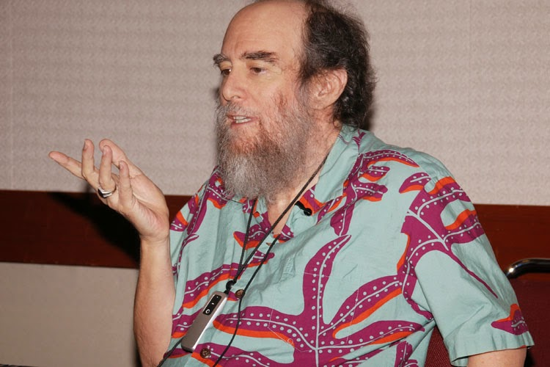
For More Information
Image of Steve presenting at the Pacific Rim International Conference on Disability & Diversity, Honolulu, HI 2014
Steve Brown: disculture@gmail.com
http://www.instituteondisabilityculture.org

