Slide 1
IL-NET Presents an IL Conversation
Join today’s conversation:
*# to enter the queue to speak
Or Type your comment in the chat box on your lower right hand side of your screen
You can also click the person with the right hand raised at the top of your screen to raise your hand to have your mic opened to speak if you aren’t using a phone
Captions will be provided in the webinar platform at the bottom of your screen. If you would prefer you can visit: https://www.streamtext.net/player?event=APRIL for full screen captions.
If you are having any trouble participating please email mary.olson@mso.umt.edu for immediate assistance
The IL-NET is a national training and technical assistance project for centers for independent living and statewide independent living councils. The IL-NET is operated by Independent Living Research Utilization (ILRU) in partnership with the National Council on Independent Living (NCIL), the Association of Programs for Rural Independent Living (APRIL), and Utah State University Center for Persons with Disabilities.
The IL-NET is supported by grant numbers 90ILTA0001 and 90ISTA0001 from the U.S. Administration for Community Living, Department of Health and Human Services, Washington, D.C. 20201. Grantees undertaking projects under government sponsorship are encouraged to express freely their findings and conclusions. Points of view or opinions do not, therefore, necessarily represent official Administration for Community Living policy.

Slide 2
Atlantis Community, Inc.
Your Life
Your Independence
Your Community

Slide 3
History of Atlantis Community Inc.
Founded by Wade Blank
Established in 1975
2nd Center for Independent Living
Notes:
Worked in a nursing home where there were children as young as 12. He started to take them out on activities but was fired as a result
He along with an attorney, John Holland sued the nursing home to start moving people with disabilities out of the nursing home
He worked with City and County of Denver to set up assisted living apartments
42 years of advocating for rights of the disability community

Slide 4
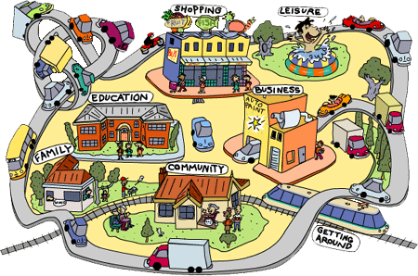
Our mission is to advocate for all people with disabilities to be a meaningful part of an integrated community of their choice

Slide 5
Who do We Serve
People with Significant Disabilities
In 2017 we provided services to over 1300 people
There were over 2400 different services provided
All ages
Services are free
Seven Counties: Adams, Arapahoe, Clear Creek, Douglas, Elbert, Jefferson
Notes:
Referrals – people with significant disabilities

Slide 6
Independent Living Philosophy
Consumer Control
Self-Help
Peer Support
Equal Access
Self-Advocacy
Integration
Full Inclusion

Slide 7
IL Process
Develop Goal
IL Plan
Meet with IL Specialist
Reach Goal
Develop new goal or Discontinue
Intake
Notes:
Goals are person driven.
Once the person requesting help has become a consumer we get to work on setting goals.
A comprehensive plan can be developed between I.L. staff and consumer but it is not mandatory.

Slide 8
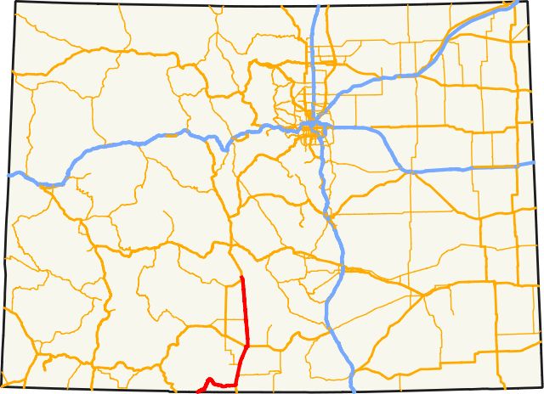
Mobile CIL

Slide 9
Obtaining your Mobile Unit
In 2016, the other CIL in Denver relinquished it’s contract leaving the Atlantis Community as the sole CIL in Denver. The Administration for Community Living had a grant to establish CILs in American Samoa, Colorado, Guam, and Kentucky. Our Executive Director had the foresight to apply for a grant to create a Mobile CIL. The Mobile CIL will support the Atlantis Community with the delivery of our core services to underserved consumers who cannot access Atlantis’s physical location due to their disabilities. It also allows us to address barriers that exist when experiencing homelessness or living in a rural part of our 7 county catchment area.

Slide 10
Obtaining your Mobile Unit
The grant proposal that Atlantis submitted aligned with the 2016 Colorado State Plan for Independent Living. Upon approval of our grant proposal, it was submitted to the Division of Vocational Rehabilitation and the Colorado State Independent Living Council.

Slide 11
Spirit of Independence Equal Access for Everyone
Notes:
13 passenger bus, 12 seats and 1 wheelchair securement area.

Slide 12
Spirit of Independence Equal Access for Everyone
Notes:
13 passenger bus, 12 seats and 1 wheelchair securement area.

Slide 13
Spirit of Independence Equal Access for Everyone
Notes:
We removed the 12 seats and customized the interior. The wheelchair securement area is still intact which gives us the ability to hire a Mobile I.L. Specialist who uses a wheelchair. We do not provide transportation for our consumers, it allows us to meet consumers where they are. In order for a consumer to be eligible for services through the Mobile Unit, there must be barriers related to the persons disability that is keeping them from reaching our main CIL.

Slide 14
Spirit of Independence Equal Access for All
Notes:
Overhead storage and an overhead auxiliary air conditioner & heater. The auxiliary air/heat allows us to work with consumers whose bodies may not regulate temperature very well. We also installed a power inverter with 2 outlets which power our printer and allows us to recharge our laptops/mobile phones/wireless hotspot etc.

Slide 15
Spirit of Independence Equal Access for Everyone
Notes:
We have 2 sources of internet. The 1st is called Internet in Motion which consists of a router and modem. We also have a wireless hotspot through our cellular provider.

Slide 16
Spirit of Independence Equal Access for Everyone
Notes:
Currently our Mobile Independent Living Unit is a 2 person team made up of myself and 1 Mobile I.L. Specialist. We did just post a job opening for our 2nd Mobile I.L. Specialist which will complete our team giving us 1 Mobile Unit manager and 2 Mobile Independent Living Specialists. Our day to day operations include conducting intakes, follow-up appointments with consumers so they can work on their Independent Living Plans and outreach days. Additionally, we attend resource fairs and other planned community events such as Project Homeless Connect and Denver Day of Dignity which offer on the spot services and resources for people experiencing homelessness.

Slide 17
Lessons Learned Rush hour in Como Colorado
Notes:
As far as we know, we are the 1st Center For Independent Living with a Mobile office, with that comes a steep learning curve. Don’t underestimate the value of your community partners and the power of nurturing those relationships. Early on, there were delays in taking possession of our Mobile Office. Fortunately our relationships with the individual county Arc offices, within our 7 county catchment area allowed us to use their conference rooms if necessary to conduct intakes and follow up appointments as those were locations that some of our early consumers could get to.
When it comes to powering equipment, there can be issues. The auxiliary ac/heat, internet in motion, and the power inverter only work when the engine is running. This is where the wireless hotspot really comes in handy since it has an internal battery. This allows us to shut the engine off even when we’re parked doing outreach unless we have to print, use the auxiliary ac/heat or recharge any of our battery powered equipment.
Be aware of your local parking ordinances when it comes to engine idling, some places will have ordinances that prohibit parked vehicles from idling for more than 30 minutes at a time.
We still have not been able to qualify for an ADA parking placard (because we don’t provide transportation for our consumers). This can be an issue for Outreach days or 1:1 appointments if the location you’re going to has limited parking. We travel with orange safety cones and if necessary we take up 2 non ADA parking spaces and use the orange cones to “reserve” space to make sure we can deploy our ramp. This has not kept us from serving our consumers yet, but it does require you to be very aware of what parking is available so you can plan accordingly, additionally, you should always have a good sense of what type of environment you’re driving into and be sure you have enough room to turn around and get back out. Not all Rural roads are maintained in the Winter months which may require finding alternate places to park/meet.

Slide 18
Thank you!
Don’t forget you can visit the IL Mobile Unit at the APRIL Conference in Denver Oct 5-8th.
Evaluation: Please evaluate this training by clicking here. https://usu.co1.qualtrics.com/jfe/form/SV_aVIblP7ycgkt9Ot
Thank you again to Atlantis for running this valuable training for us! Don’t forget you can access the archives for this training and all trainings at the ILRU website and the APRIL website.

