Slide 1
Equipping Youth for Advocacy
Emily Beasley
Youth Leadership Coordinator
Able SC

Slide 2
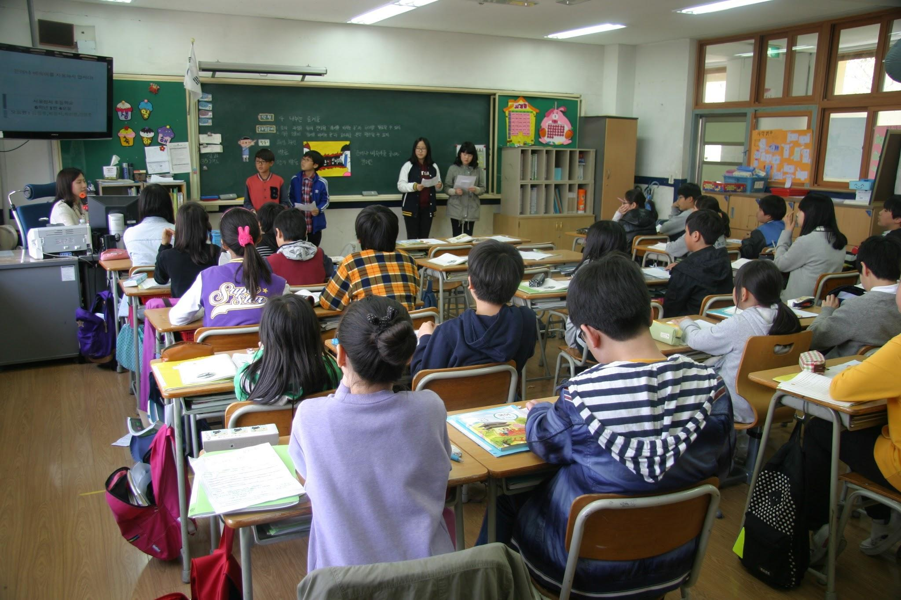
Segregated Classrooms
Notes:
In America, 83 percent of students with intellectual disabilities are in segregated classrooms. 87 percent of students with more than one disability are in segregated classrooms. Special education, autism specific classrooms, and self-contained classrooms, all of those titles are fancy names for segregated classrooms. Segregated mean separate from everyone else. A segregated classroom only has people with disabilities in it. The people with disabilities do not get the opportunity or get very limited opportunities to be with their peers without disabilities.These students are in these classrooms because teachers think they need more one on one attention and think that they make be a distraction or take away from their peers without disabilities. Some of these students are in the classroom for 1 to 6 hours a day while the rest spend their whole day seperate from their peers. These classrooms are not okay. In fact, they harm students with disabilities. They are harmful because the students in these classrooms are not with their peers, they actually receive less educational instruction, and they have fewer opportunities to learn and use their knowledge. These students are not given the opportunity to socialize with their peers without disabilities, yet they are expected to act like their peers without disabilities. The majority of these students do not graduate from high school with a high school diploma. The expectations of these students are very low. They are not expected to be able to learn. They are not expected to be able to graduate. They are not expected to get a job after school. Take two minutes and think about this information. What are your thoughts on segregated classrooms? Do you think that it is fair that students are segregated from their peers just because they have a disability?

Slide 3
Think, Pair, Share

Slide 4
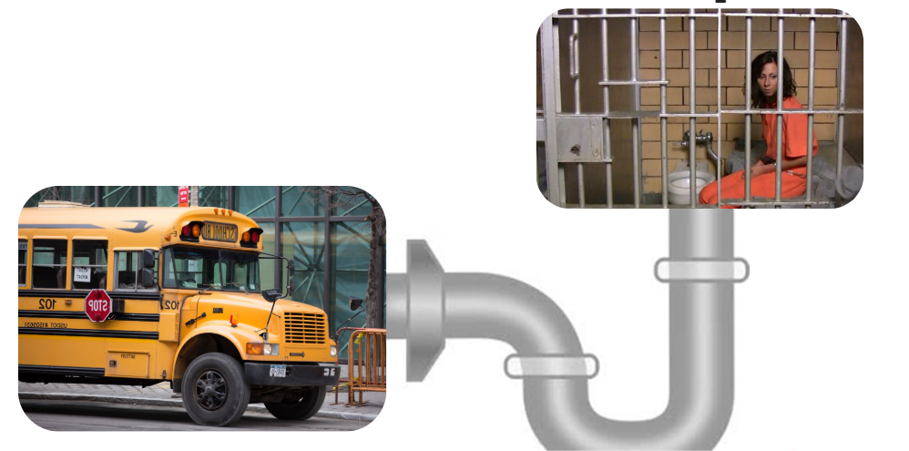
School to Prison Pipeline
Notes:
Students with disabilities make up 12% of the school population but they are disciplined more often. Students with disabilities are twice as more likely to receive an out of school suspension, they make up a quarter of all school arrests, they make up over half of students put in seclusion, make up three fourths of all students physically restrained, and they make up 85% of all students in juvenile detention. Because these students have labels due to their disability, these students are more likely to be disciplined for something than a peer without a disability doing the same thing. The school to prison pipeline affects students with disabilities and students of color. These students, because they face more disciplinary actions, are more likely to end up in prison. What are your thoughts on this? Do you think it is okay that students with disabilities are more likely to be punished for actions on the sole basis of their disability?

Slide 5
Think, Pair, Share

Slide 6
After High School Options
Notes:
For students with disabilities, there are two routes when it come to high school. Some students with disabilities graduate with a diploma, like their peers without disabilities, while the rest graduate with a certificate of completion, unlike their peers without disabilities. With this certificate, they cannot go to college. If they are lucky, they may be able to get into a technical school or program. Only 41.9% of people with disabilities have some or graduate from college. Less than half of people with disabilities. While it is not required to have a meaningful life, college and post secondary education is associated with more income and an easier life. Overall, those who don’t go to college may not end up employed either. Only 17.6% of people with disabilities are employed. Among those who are employed, some are paid below minimum wage. Currently, the minimum wage is $7.25. In some sheltered workshops (where people work for subminimum wage), the people make only $0.25 an hour. These jobs are often small repetitive tasks that offer no chance for growth for the people who work there. These jobs are offered out of pity and low expectations. It is illegal to pay workers without disabilities below minimum wage (excluding waiters/waitresses). However, it is perfectly legal to pay people with disabilities less than minimum wage on the sole basis of their disability. Do you think this is fair? What do you think this implies about people’s views of people with disabilities?

Slide 7
Think, Pair, Share

Slide 8
Institutionalization
Notes:
An institution is a public or private place for the care or confinement of people. An institution can be a psych ward, a hospital, a jail, etc. Each year, hundreds of thousands of people with disabilities are confined to an institution on the basis of their disability. In these institutions they are restricted in many of the same ways as the person with a guardian. They do not get to decide where to live. They do not get to decide who they live with. They do not get to decide when they can enter or leave. They can have restrictions on when they can use the phone or the internet. All of those restrict their access to the community. In these institutions expectations are low. They are not expected to be able to leave this place and live independently. All of their decisions are made for them. In many places, they do not even get to decide what they will wear day to day. Most of the time, people are put in institutions against their will. They do not decide to live there. Take a few minutes and let this sink in. Write down on your notecard your thoughts on institutions and the fact that people with disabilities are put their against their will just because they have a disability. Does that sound like a place you would want to be?

Slide 9
Think, Pair, Share

Slide 10
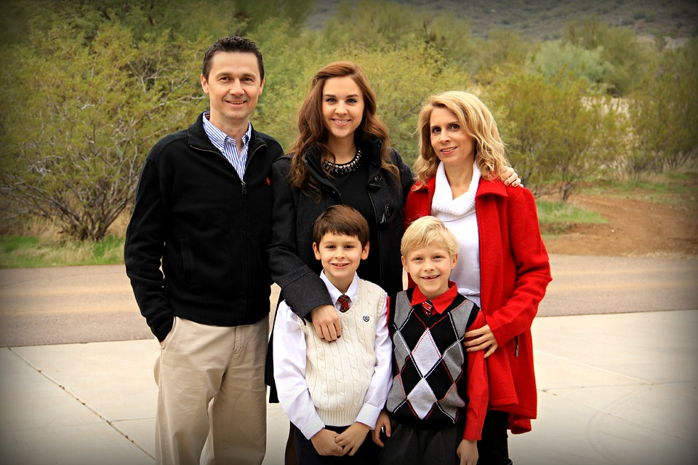
Guardianship
Notes:
From 1995 to 2015, 1 million new people were put under guardianship. Guardianship is a legal relationship established by the court in which a person is given legal authority over another person when he or she is unable to make safe and sound decisions regarding his or her person, or property. The court is the one who makes the decision on who will be put under guardianship. When a person is assigned a guardian, they are declared an incompetent adult. Incompetent means unable to make decisions on one's own life. Many parents try to obtain guardianship over their kids with disabilities because they are afraid that their kids will make the wrong decisions or may not understand what is being asked of them when it comes to making important decisions. Guardians control every aspect of a person’s life. They control whether a person can get married, where they will live, what medical treatment and procedures a person receives, whether they can drive, whether they can vote, whether they can have a job, what education the person is allowed to get, where the person can go, and who the person can be friends with. Now that you know a little bit about guardianship and what it means, I want you to write down any thoughts or questions you may have on a notecard. Think about whether or not you would want someone to be your guardian. Would you want someone else making your decisions? Would you want someone else controlling your life?

Slide 11
Think, Pair, Share

Slide 12
Action Plan and Name Tag

Slide 13
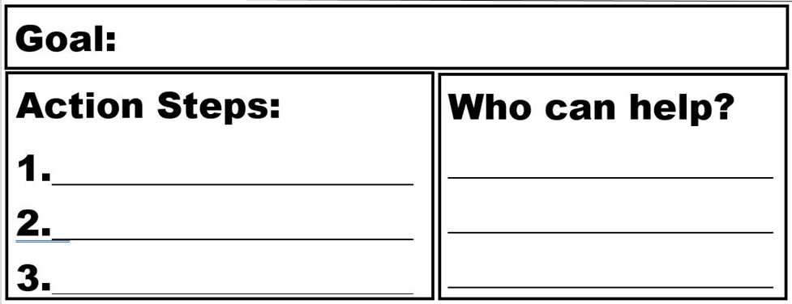
Action Plan and Name Tag

Slide 14
Questions?
Contact me at (803)779-5121 ext.223 or at ebeasley@able-sc.org

