Slide 1
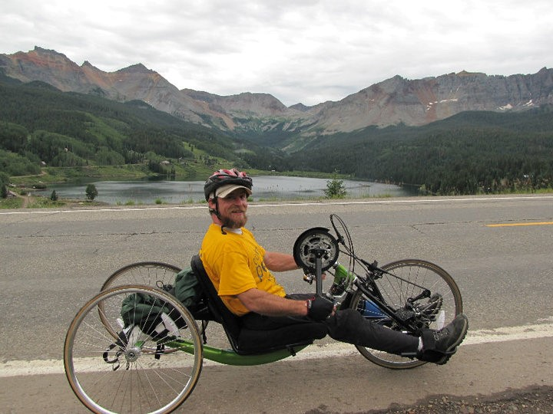
Adaptable Sports
Ian is centered on his 3 wheel hand-cycle bike stopped on the road. He is centered in the camera, looking at the camera. Behind him are mountains with a lake. Hues of green go up the mountain from the lake to a cloudy sky.

Slide 2
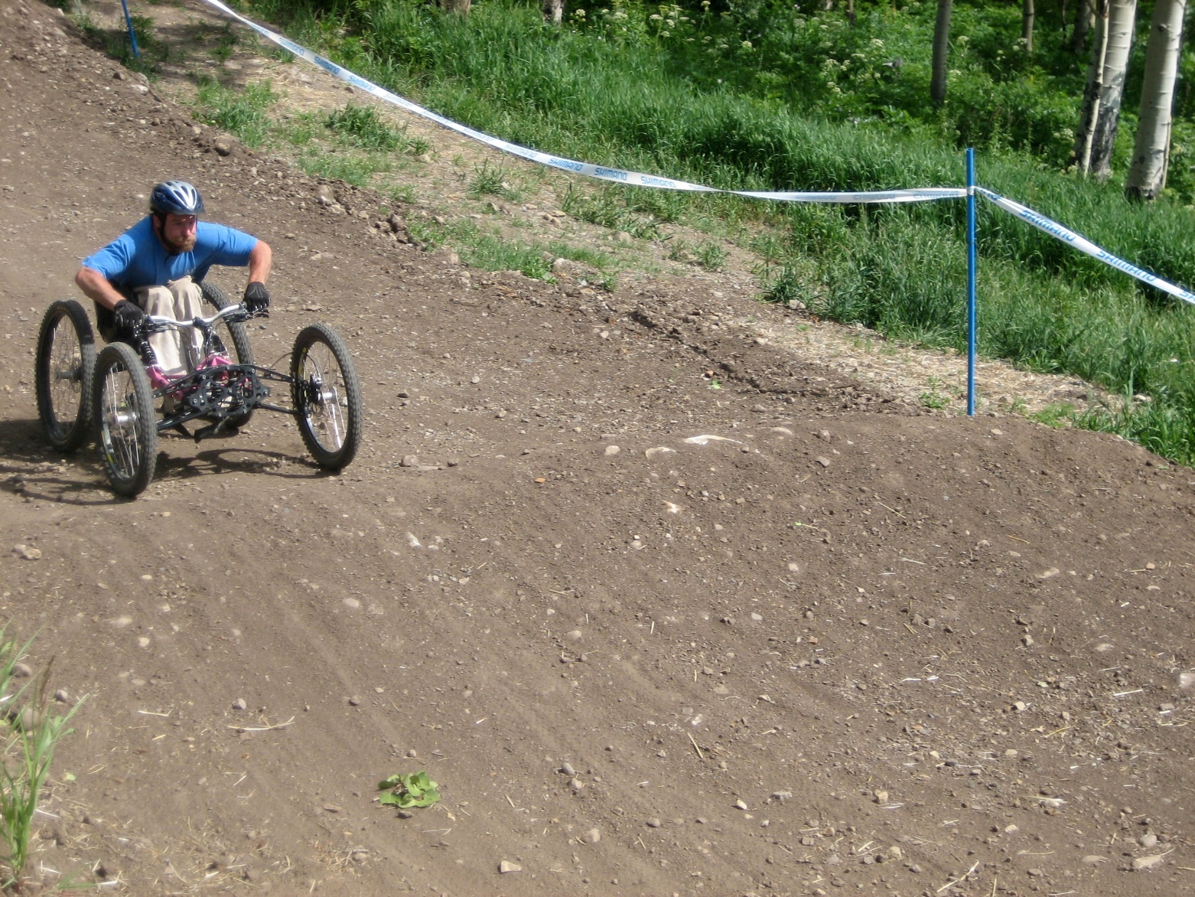
Adaptable Mountain Biking
Ian is on a 4 wheel adapted mountain bike about to make a jump on a dirt course

Slide 3
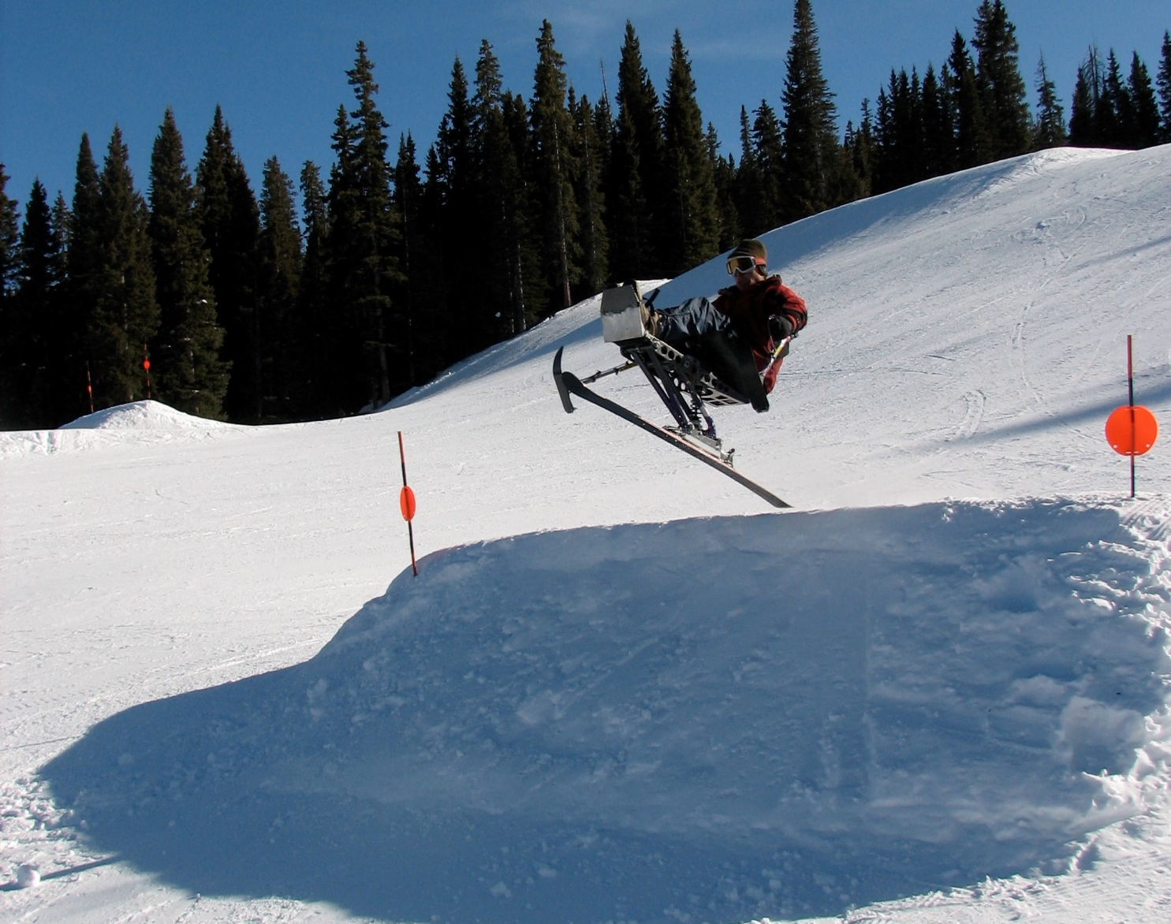
Adaptable Skiing
Ian is in the middle of a jump on the mountain. Looks to be about 10 feet off the white snow.

Slide 4
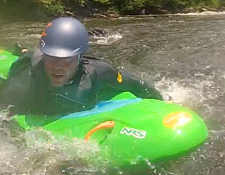
Ian Belly-yakking
Yes, it is a word! Ian is laying on a bright green, flat, board in the middle of rapids on a river.

Slide 5
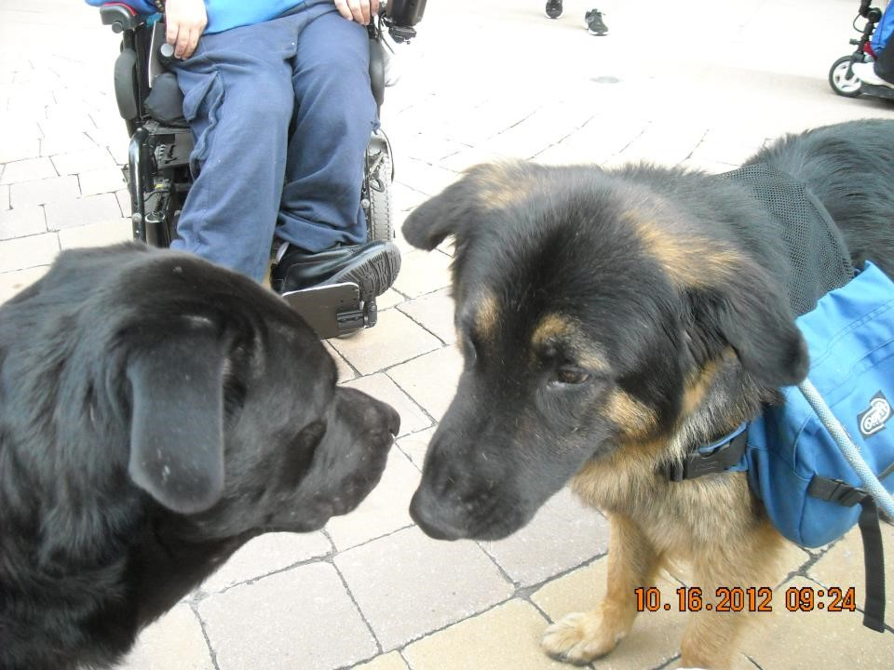
Roku and Aslan
Roku, a black lab and Newfoundland mix, and Aslan are almost nose to nose. It is as if Roku is saying to Aslan “Do NOT go to the tree in the park… it is NOT an accessible bathroom”

Slide 6
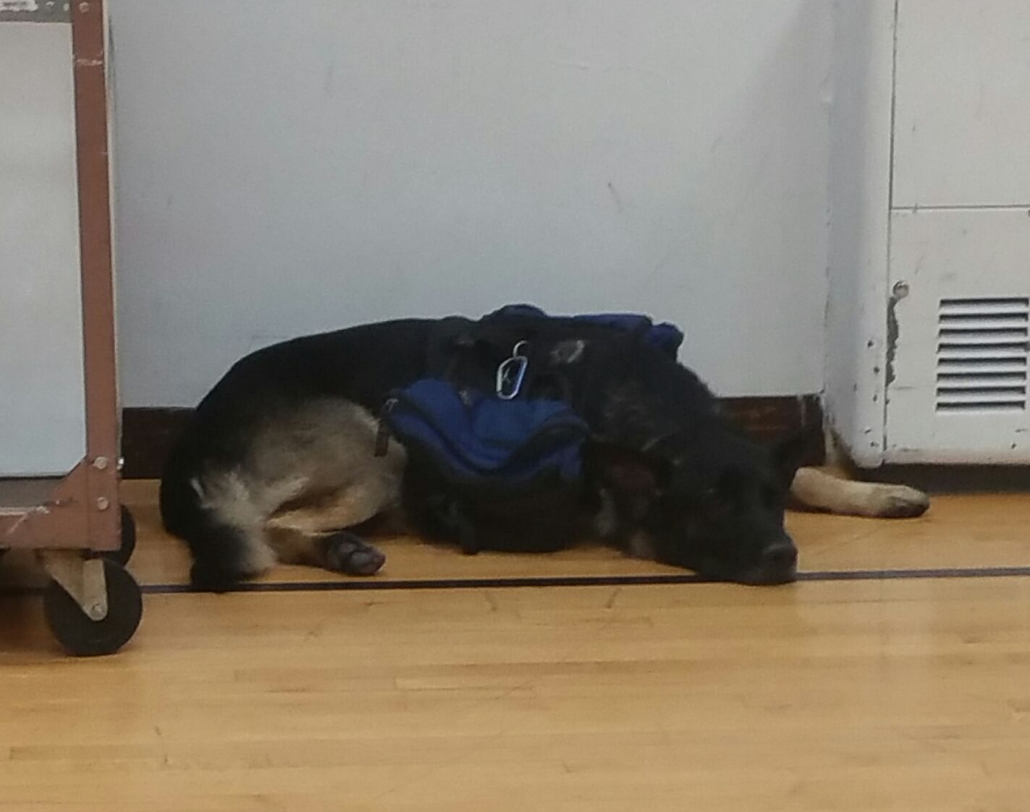
Bored Zuma
Zuma is laying on the gym floor waiting, waiting, waiting for the Statewide Independent Living Council to be OVER.

Slide 7
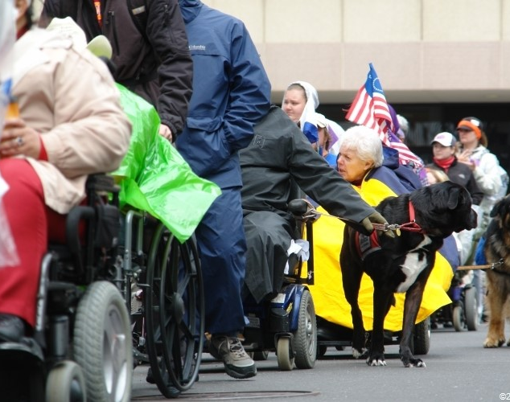
Roku looking at Aslan
A line of people with disabilities at a rally. Centered is Roku looking back at Aslan as if to say “hurry up”

Slide 8
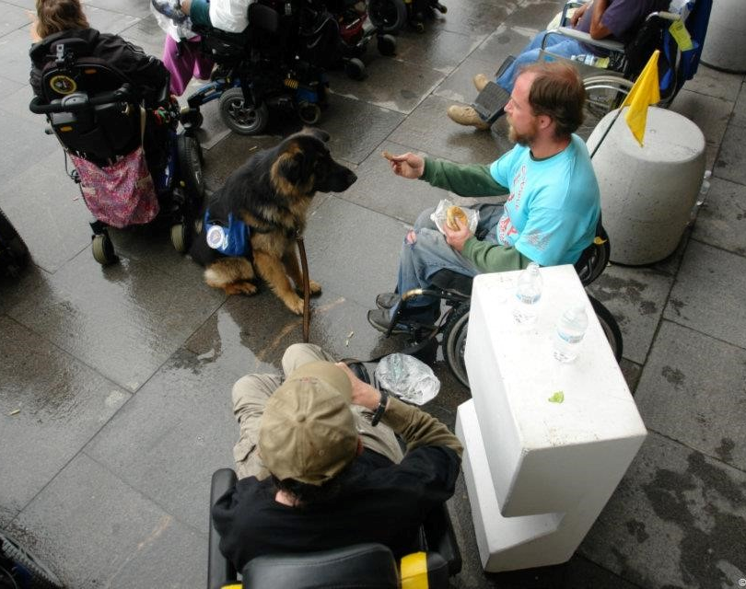
Hamburger Helper
Ian is handing a piece of McDonald’s hamburger to Aslan.

Slide 9
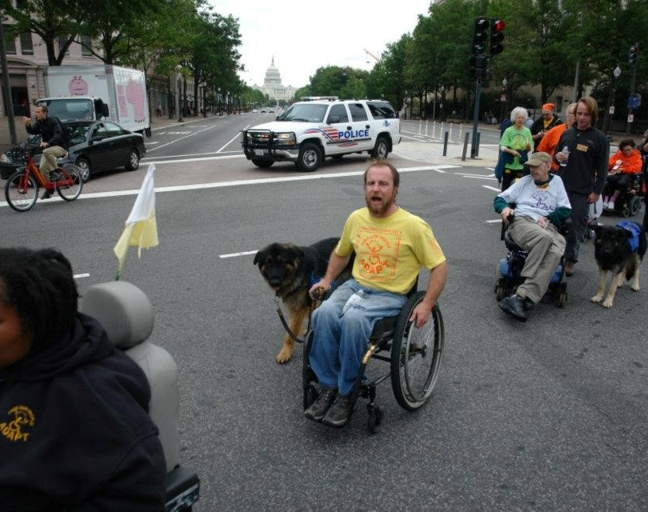
Rally
A march in DC. Ian is centered with Aslan. Police car is in immediate background with the Capitol in the far back.

Slide 10
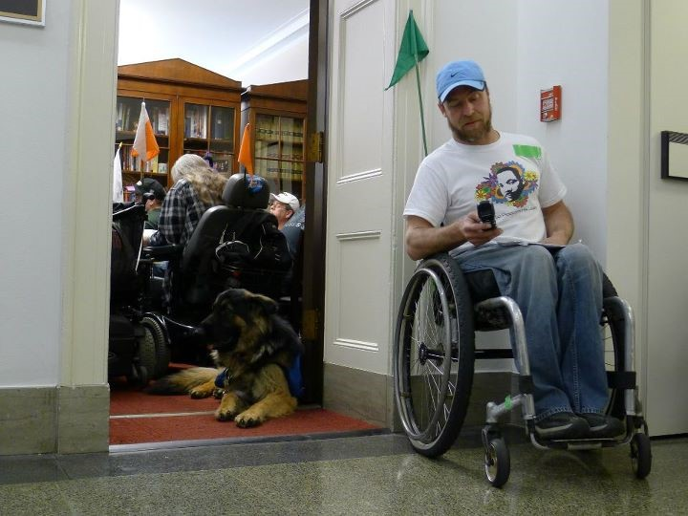
Still at Paul Ryan’s
Ian is using a flip phone (dating Ian) outside in a hall on the other side of Paul Ryan’s office. In the open doorway laying down is Aslan. Several people are in the office blocking the way.

Slide 11
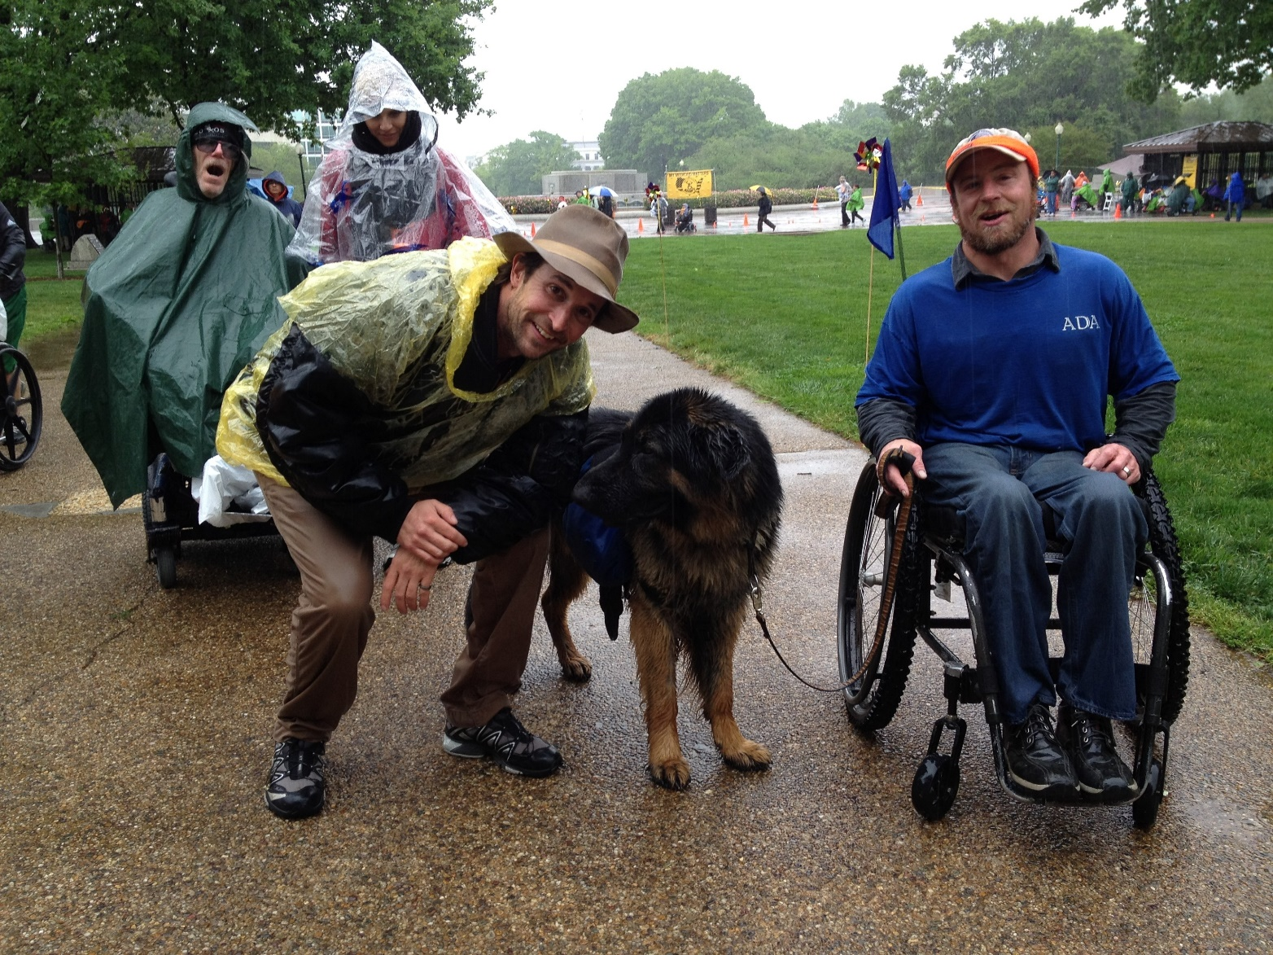
DC Rally
Noah Wiley (of ER and the Librarians to name a couple shows he was on) met Ian and Aslan (a German Shepherd who was Zuma’s uncle). It is raining and Aslan is wet. Noah is bending down level with Aslan and looking at the camera. Ian is on the other side of Aslan. Two people are behind them. Everyone but Aslan and Ian have on rain slickers.

Slide 12
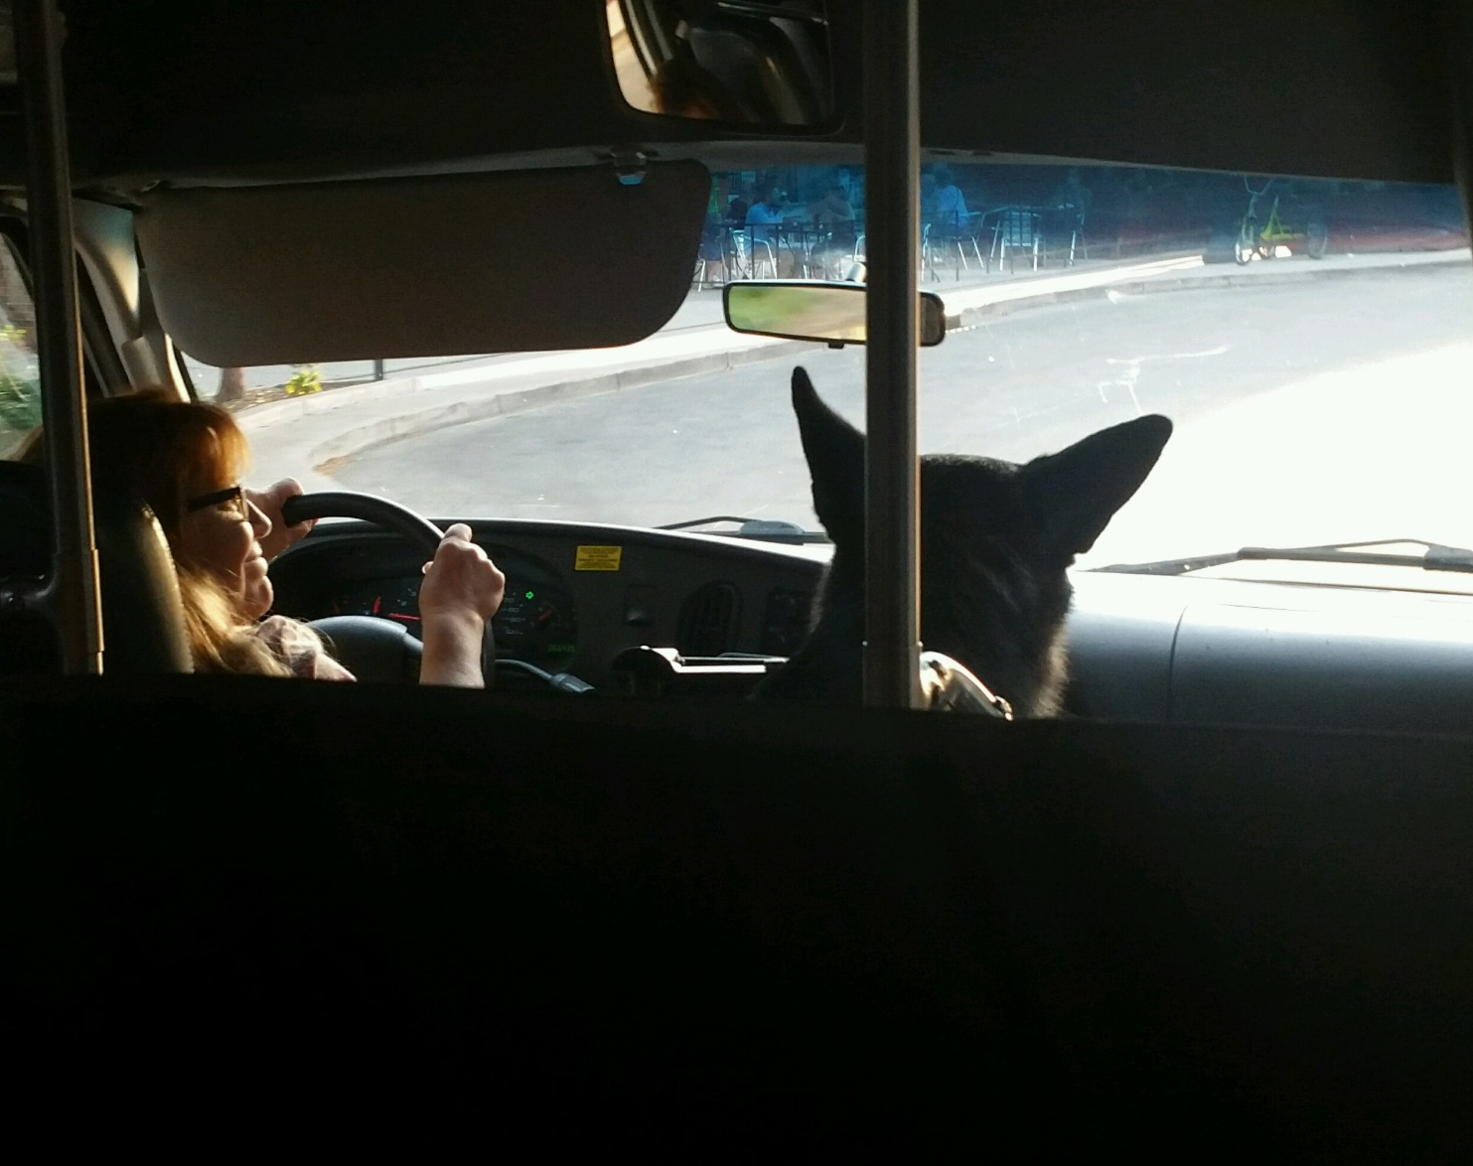
Riding Accommodation
A woman is driving, her name is Linda if you are dying to know, and she is looking to her right at Zuma, Ian’s service dog. It appears he is giving her directions.

