Slide 1
How to use the community to get what you want

Slide 2
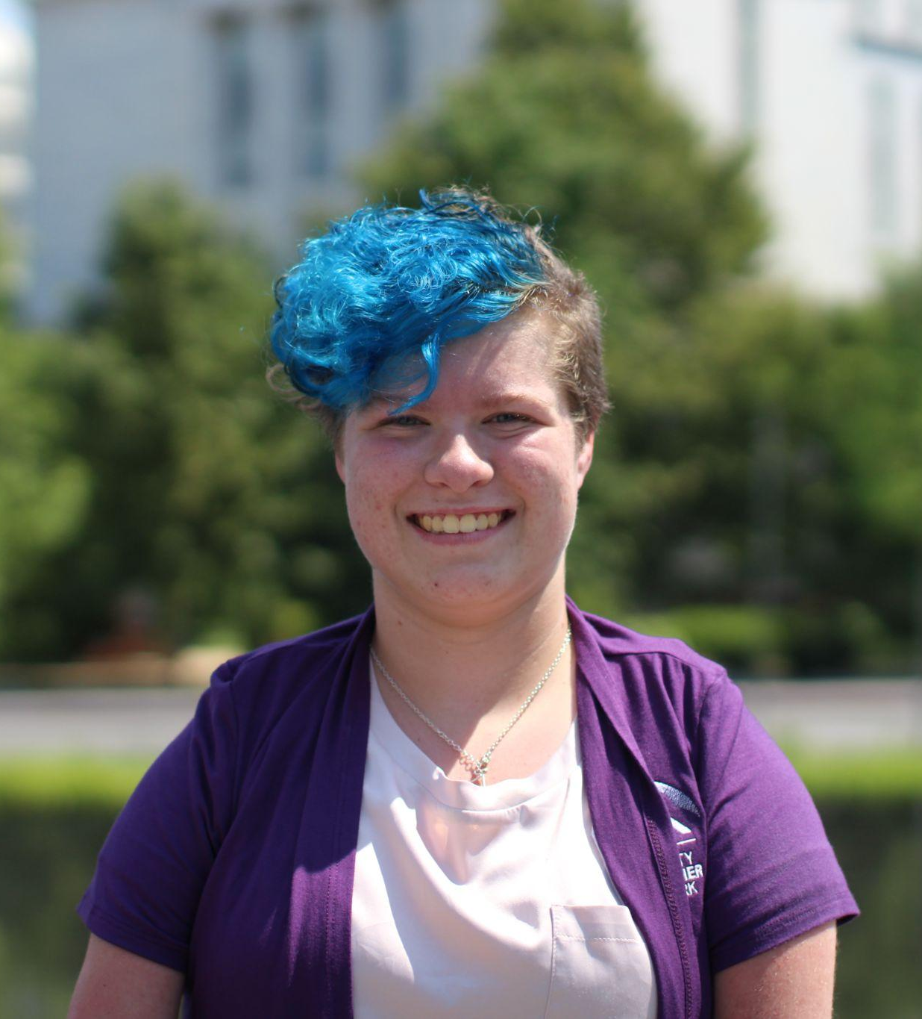
HELLO!
I’m Mia Howie
About Me:
I am a senior that lives in a small town named Palmyra. I really enjoy many things including playing video games, baking, drawing, & being with friends & family!
You can find me at Mia.howie@icloud.com
or
(315)667-0870

Slide 3
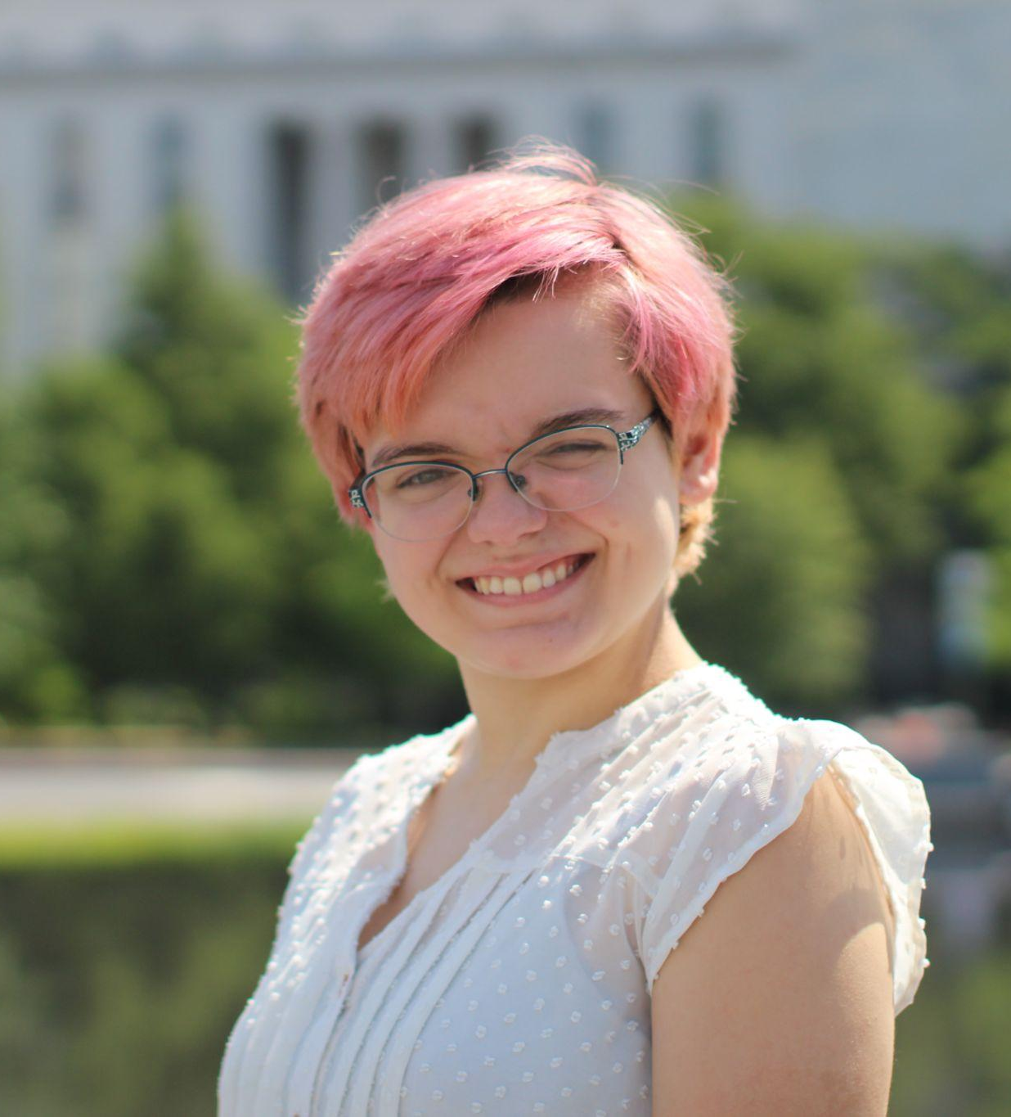
HELLO!
I’m Lily Wells
About Me:
I am a junior in high school, and am from a small town called Urbana-Champaign. I enjoy reading, traveling, and advocating for human rights! I am also a big video game fan!
You can find me at
13lilyw@gmail.com
or
(217)-318-9814

Slide 4
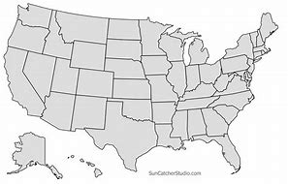
Where do we live exactly?
https://suncatcherstudio.com/patterns/us-maps/

Slide 5
Previous Projects
1
Let’s start with Lily telling us about her project

Slide 6
A new Bus Shelter
1
My project was on prioritizing the installation of a bus shelter near my local independent living center.
My reason for a new bus shelter being the fact that my hometown’s wind makes the cold weather seem even colder, which can make disabilities feel worse.

Slide 7
Disability Empowher Network
What do you think the logo stands for in Disability EmpowHer Network?

Slide 8
Meaning of Disability Empowher Network logo
The logo stands for a mentor and mentee sharing a bond which helps them spread advocacy and change.

Slide 9
Visiting a domestic violence shelter
1
My project took some time to get started because I had to find a shelter that was willing to work with me.
I learned many things along the way…
How many women each day are raped or sexually assalted?

Slide 10
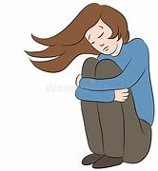
500 women
Whoa! That’s a big number!
That’s 1 in 4 women each day, according to
futures without violence!
https://www.futureswithoutviolence.org/

Slide 11
Our different Communities
2
Why it’s important to have support

Slide 12
Why I needed support during my project
2
Future involvement
Tried asking bus station for help
Discovered local disabled community
Gave Me Ideas
Talked to mentor
Said Come to meeting
Gained more connections
Contacted PACE
Notes:
So during my project, I reached out to my local bus station, asking for their help, but because I was the only person bringing this up, they kept saying no.

Slide 13
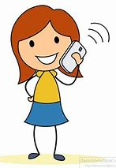
How I got my support during my previous project
2
Hey Jill & Mandie! I’m stuck on this project!
Sometimes you just have to find your community!
Jill: you should do a domestic violence shelter!
Mandie: Good idea guys! I’ll call around, see if I can find a shelter!

Slide 14
Being leaders
3
What does that mean in different ways

Slide 15
Leading in different ways
3
I usually lead with words and empowerment, which is very important when speaking to different groups.
I use online resources to my advantage, creating posts and petitions.

Slide 16
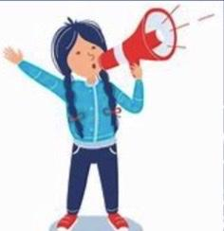
Leading in different ways continued
3
I let my community know the big issue is in our community
I led myself and mentor through an online training to become a Certified Inclusion Ambassador

Slide 17
How can all of you lead?
How do you lead in your daily life?
Is there any time that you’ve led where you’ve felt particularly proud?

Slide 18
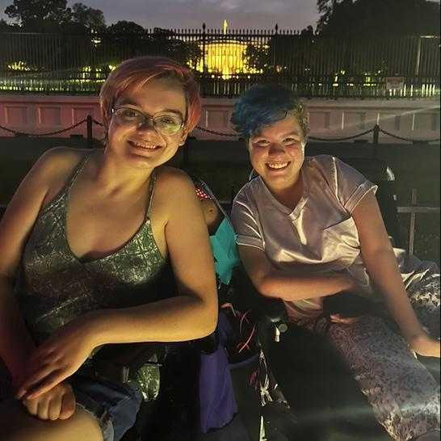
THANKS!
Any questions?
You can find us at:
13lilyw@gmail.com
mia.howie@icloud.com

Slide 19
Slides Carnival Credit
Free templates for all your presentation needs
For PowerPoint and Google Slides
100% free for personal or commercial use
Ready to use, professional and customizable
Blow your audience away with attractive visuals

