Slide 1
Discussing Ways to Advance Disability Community Priorities through Managed Care
Rick Fredrickson, Regional Vice President of Long Term Care, Centene
Thomas Earle, CEO, Liberty Resources
Jeff Hughes, Executive Director, Progressive Independence

Slide 2
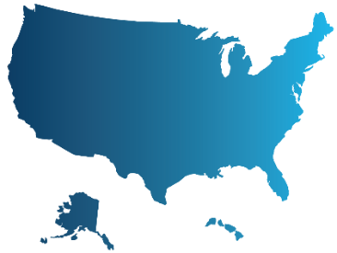
Centene At A Glance
Largest Managed Long-Term Services and Supports (MLTSS) plan in the country.
26.4M Managed Care Members
15.4M Medicaid members across 29 states
1.5M Medicare members across 36 states
2.0M Marketplace members across 27 states
4.2M Prescription Drug Plan members in 50 states
365K members accessing LTSS through Medicare-Medicaid Plans (MMP) & MLTSS across 15 states
AR, CA, FL, HI, IA, IL, KS, NJ, NM, NY, OH, PA, TX, MI (MMP), SC (MMP), DE (2023)
©2021, Fortune Media IP Limited. All rights reserved. Used under license.
Notes:
At Centene, we are committed to providing meaningful, high-quality healthcare to every member. Those members remain at the forefront of all we do across our organization.
We are diversified, multi-national FORTUNE® 100 company, committed to Transforming the health of the community, one person at a time.
With more than 64 thousand diverse and dedicated employees providing healthcare services to nearly 24 million members across all 50 states, we are proud to be the largest Medicaid managed care organization in the country, the national leader in managed long-term services and supports, and the number one insurer in the nation on the Health Insurance Marketplace.
That means, we serve one in 15 individuals across the nation.
That is an incredible privilege … And responsibility.
The bold steps we take as a leader in healthcare are supported by a solid, mission-driven foundation, and guided by the shared sense of purpose on which our organizations have been built.

Slide 3
Diversity Equity and Inclusion (DEI) at Centene
Centene National Disability Advisory Committee (CNDAC)
Employee Inclusion Groups (EIG)
ABILITY: People with Disabilities & Caregivers Network
Employment of People with Disabilities
Recognized with a 100% score on the Disability Equality Index (DEI) and named one of the Best Places to Work for People with Disabilities
Self-ID Campaign enables Centene to evaluate the effectiveness and responsiveness of DEI programs and initiatives
10% of employees self-identify as a person with a disability

